Slide 1
A Study on Loss Functions for Adversarial Finetuning of Contrastive Models
Advisor: Prof. Sanjeev Kumar
Aayan Yadav (22323001) and Shree Singhi (22125035)

Slide 2
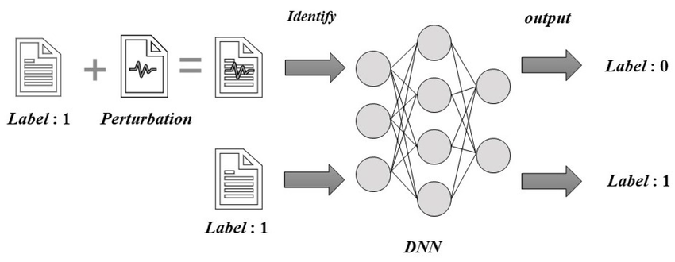
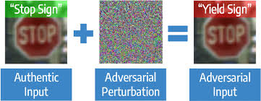
Adversarial Attacks

Slide 3
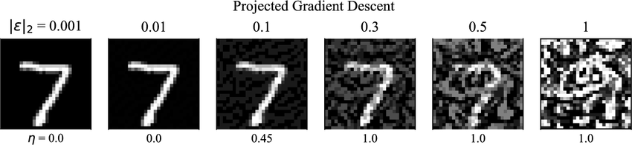
Computation of Adversarial Attacks

Slide 4
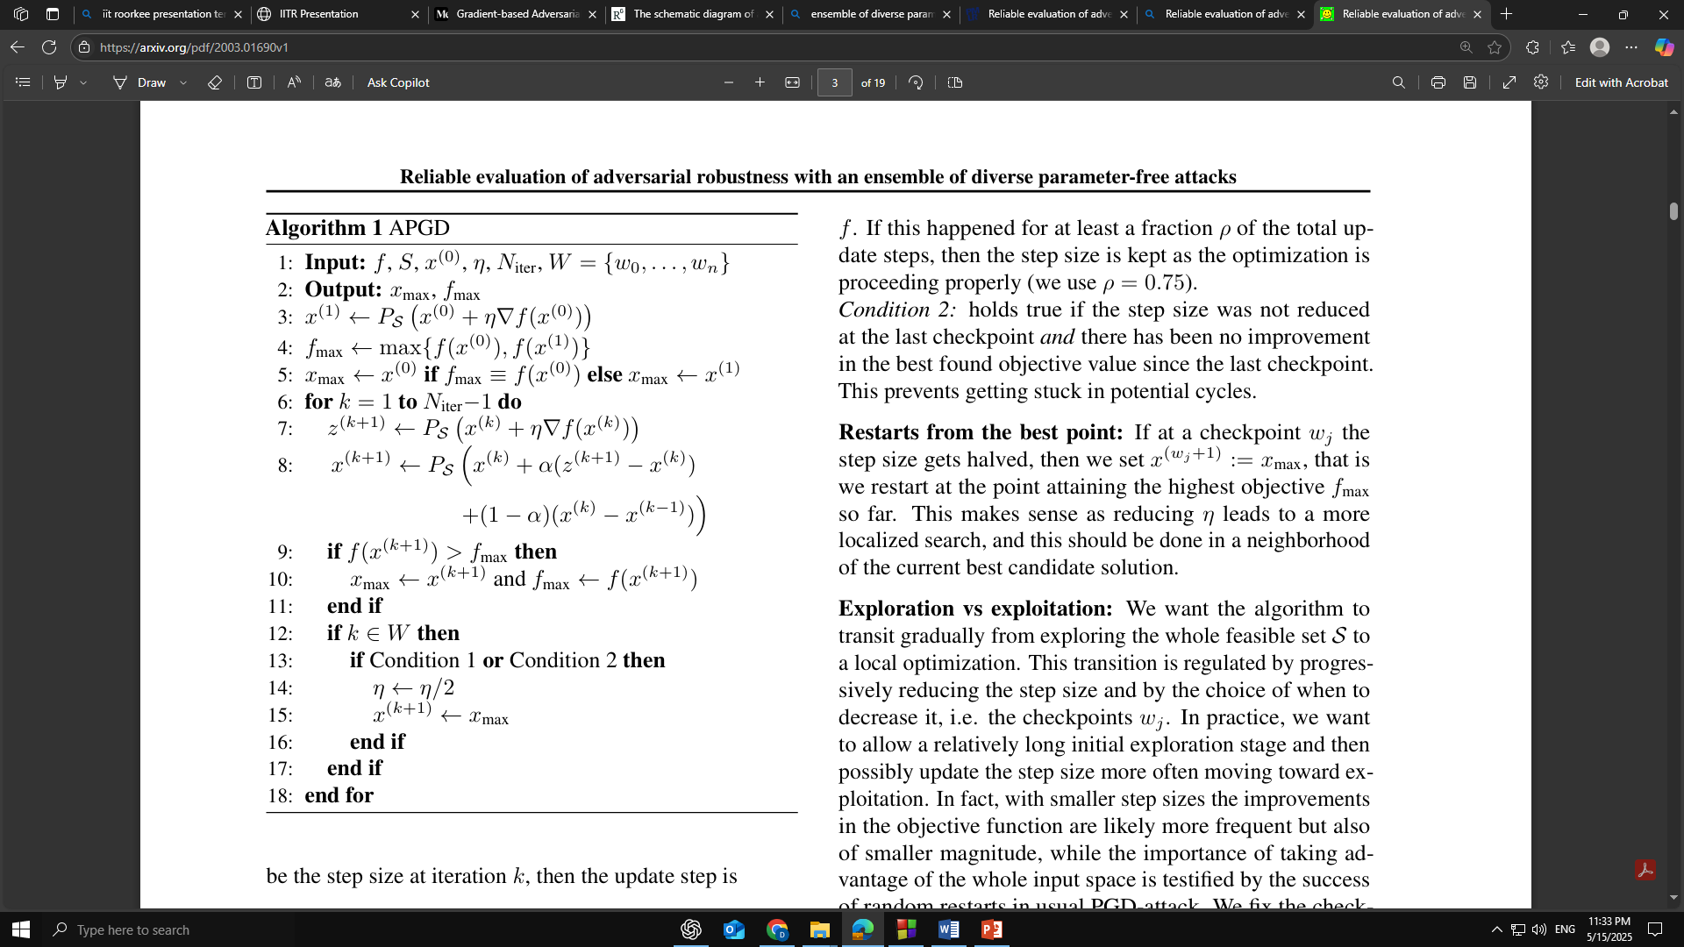
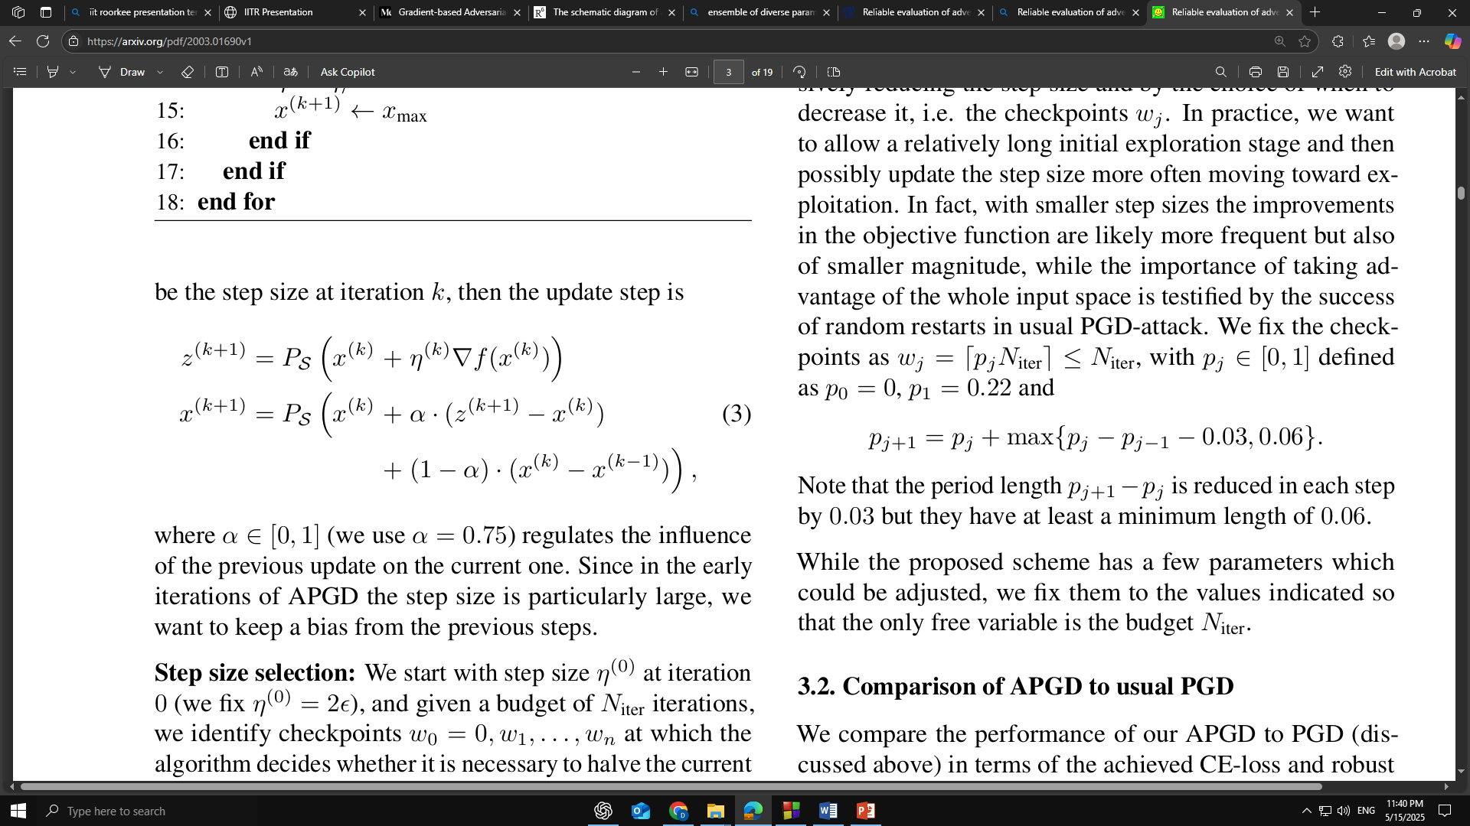
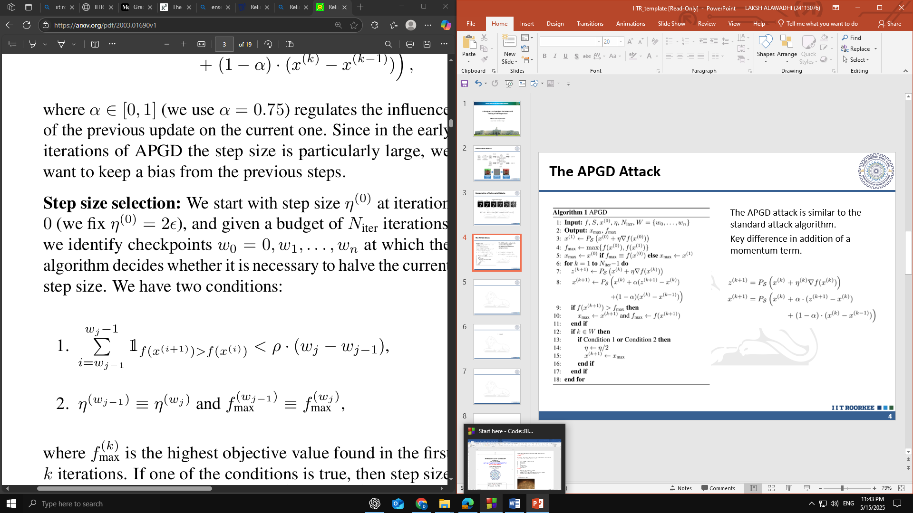
The APGD Attack
The APGD attack is similar to the standard attack algorithm.
Key difference in addition of a momentum term.
Croce, F. &amp; Hein, M.. (2020). Reliable evaluation of adversarial robustness with an ensemble of diverse parameter-free attacks. Proceedings of the 37th International Conference on Machine Learning, in Proceedings of Machine Learning Research 119:2206-2216 Available from https://proceedings.mlr.press/v119/croce20b.html.
Notes:
Condition 1: counts in how many cases since the last check point wj−1 the update step has been successful in increasing f. If this happened for at least a fraction ρ of the total up date steps, then the step size is kept as the optimization is proceeding properly (we use ρ = 0.75).
Condition 2: holds true if the step size was not reduced at the last checkpoint and there has been no improvement in the best found objective value since the last checkpoint. This prevents getting stuck in potential cycles.

Slide 5
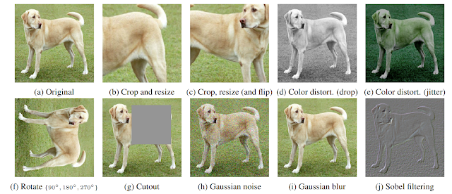

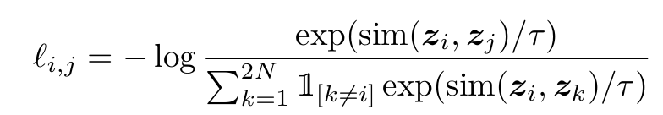
Contrastive Learning- SimCLR
Training is performed by passing two different transformations of the original image through same model, and minimizing the embedding distance after projection layer
Notes:
Batch size and model size, training time increase always significantly helps performance
Explain how the effect of changing batch size is non trivial

Slide 6
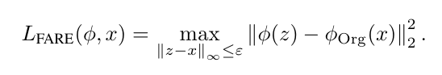
Robust CLIP: Unsupervised Adversarial Fine-Tuning of Vision Embeddings for Robust Large Vision-Language Model
The authors train on ImageNet-1K dataset
Text embeddings are extracted for each class using “This is an image of ____” with the text encoder. Image embeddings are extracted using the vision encoder
Attack is generated by minimizing the cosine similarity between both embeddings
Objective function for training is:
Trained for 20k steps on PGD attack

Slide 7
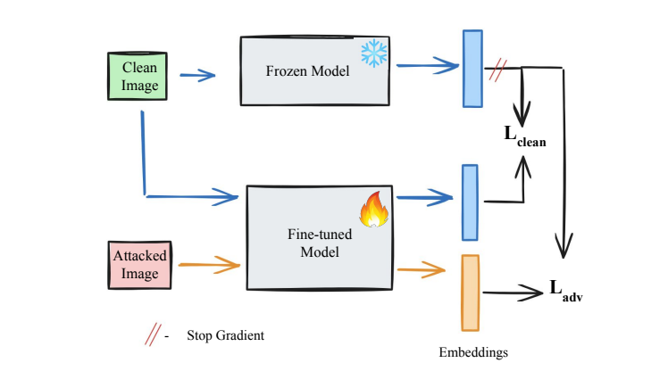
Our Method
We noticed that the new adversarial embedding space “forgot” details of the of the original distribution since the finetuning loss term had no objective of retaining clean model performance.

Slide 8
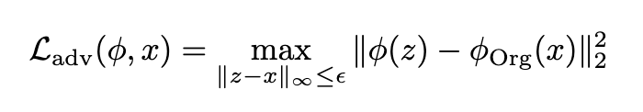
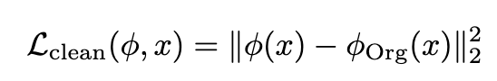
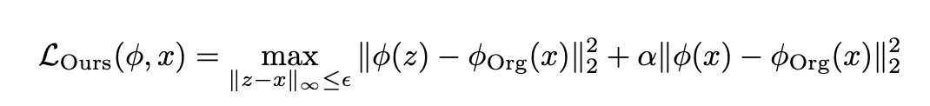
Our Method
We add a new term that pushes the two different model embeddings of the same clean image together

Slide 9
Implementation Details
Model: Trained a linear layer on CIFAR10 and ImageNet with SimCLR-trained ResNet50 backbone
Frozen linear layer weights were trained for classification followed by APGD attack of 10 steps with epsilon value of 8/255.
AdamW optimizer: with varying learning rates, β1=0.9, β2=0.95
Learning rate: Cosine learning rate decay with linear warmup for 1,400 steps and training of 20,000 steps with a batch size of 256

Slide 10
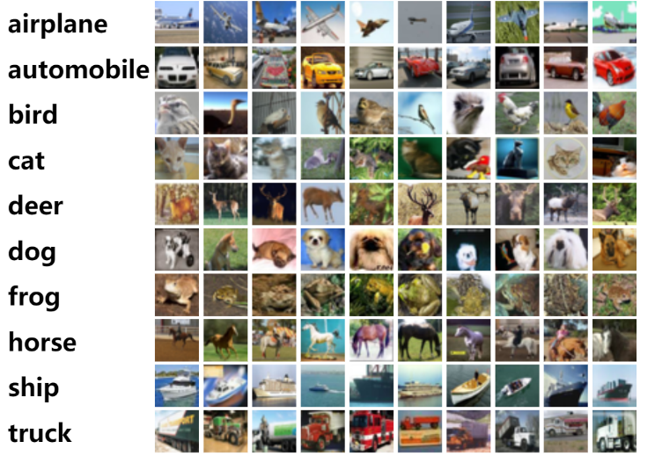
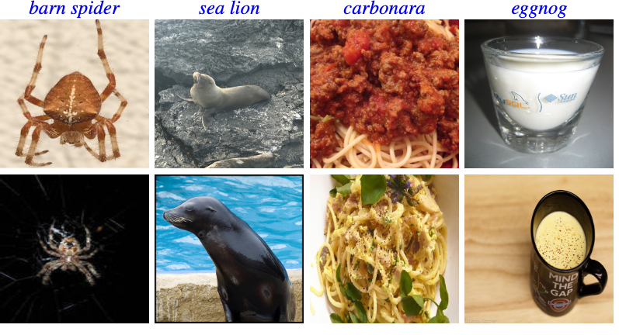
Dataset Details
CIFAR10
ImageNet-1K
32 x 32 RGB images with 10 classes
50K images in training set and 10K images in test set
Varying image sizes of larger resolution with RGB and grayscale images
1000 different object classes
1.2M in train set, 50k val set

Slide 11
Hypothesis
We expect that the model’s adversarial image classification performance would stay roughly the same, with slight decrease
We expect that the clean image classification performance of the model would improve.
The embeddings of the original model and fine-tuned model were expected to stay the same, on clean images, since the clean loss term would minimize the difference between both embeddings

Slide 12
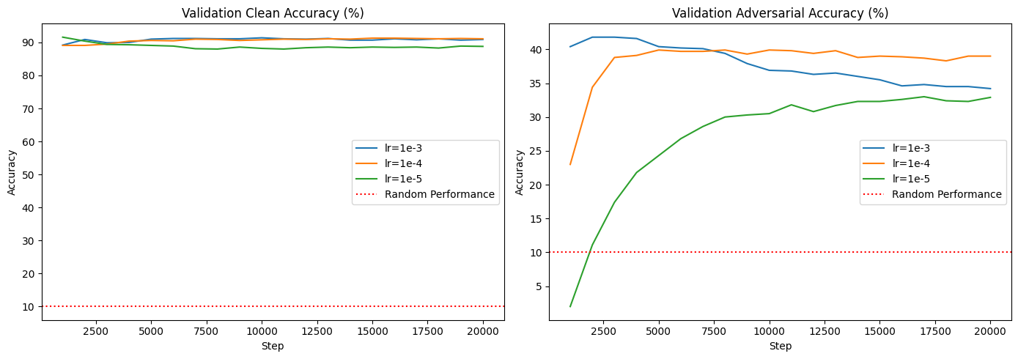
Results on CIFAR10 with varying learning rate
Learning rate of 1e-4 gives the most optimal result (Clean weight = 0.1)

Slide 13
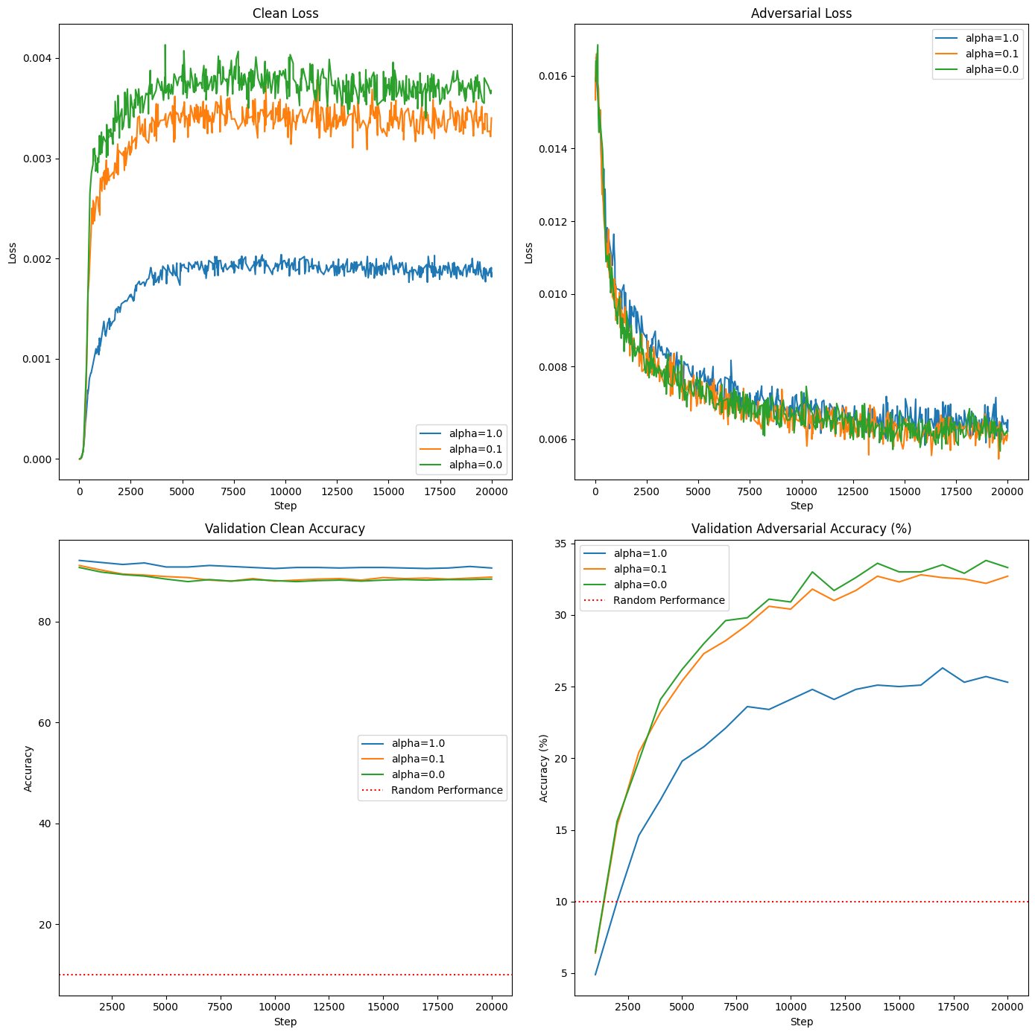
Results on CIFAR10 with varying alpha
Training loss behaves as expected
Difference in clean accuracy minimal
Introduction of clean loss term causes overfitting with respect to adversarial example
Overfitting?

Slide 14
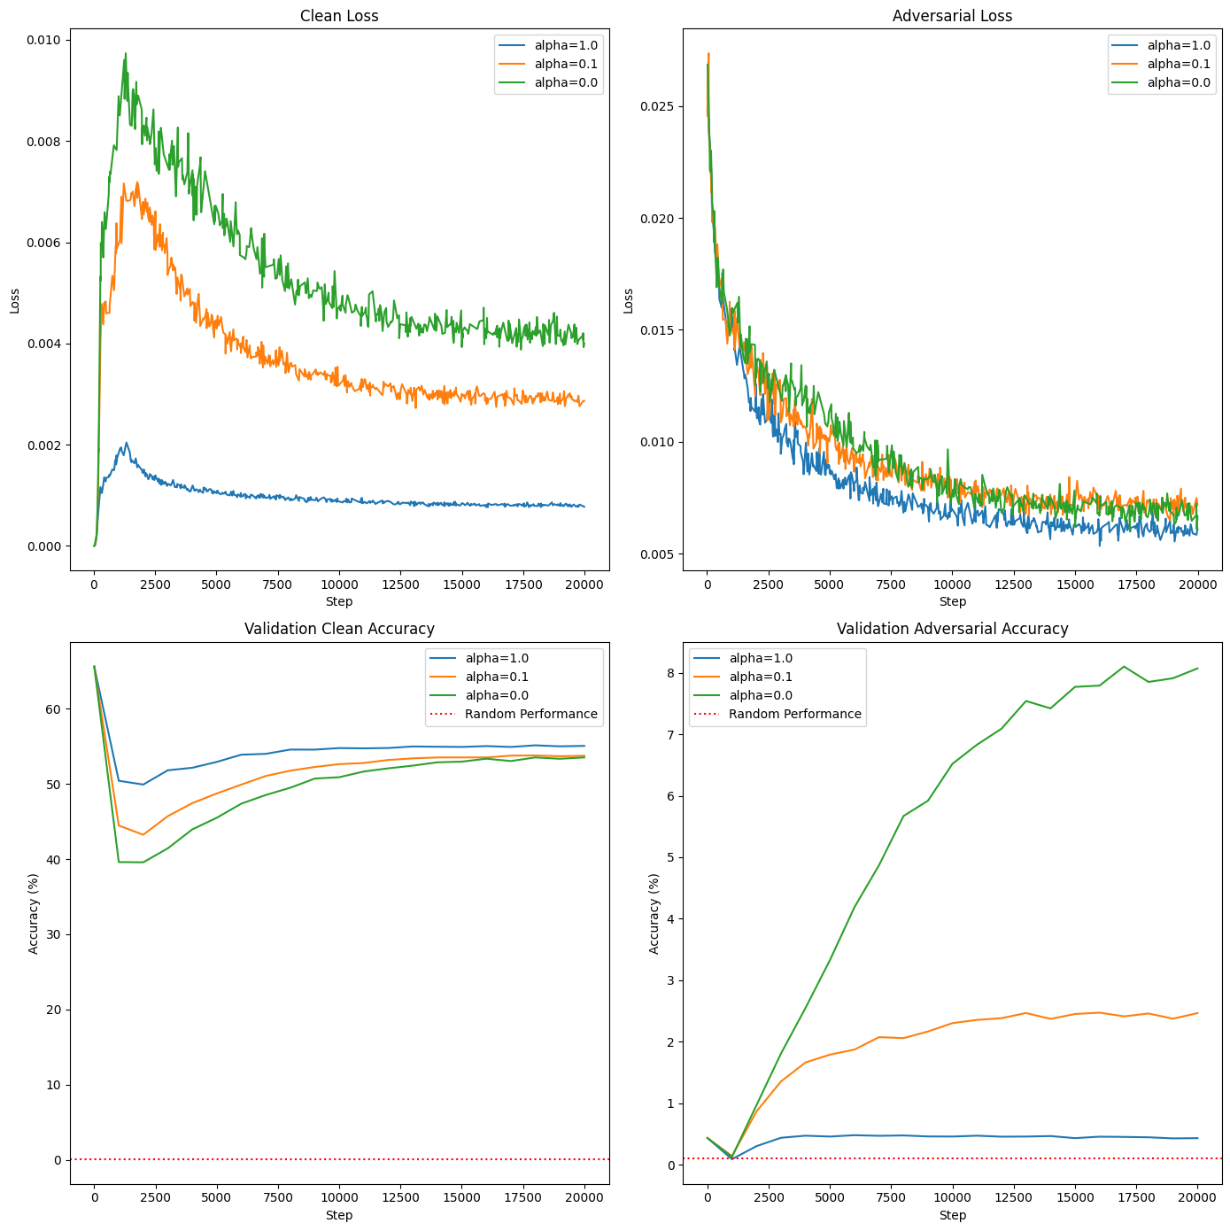
Results on ImageNet-1K
Training loss behaves as expected
Difference in clean accuracy initially but converges over time
Introduction of clean loss term causes overfitting with respect to adversarial example

Slide 15
Conclusion
Introduction of additional term which minimizes the L2 distance between embedding of clean images on original and finetuned model causes overfitting in adversarial learning task.
Restricting embedding space in a L2 sense does not boost performance on clean images while causing overfitting on adversarial images.
Maybe some other distance measure can give better results.

Slide 16
References
He, K., Zhang, X., Ren, S., & Sun, J. (2015). Deep residual learning for image recognition. arXiv preprint arXiv:1512.03385. https://arxiv.org/abs/1512.03385
Chen, T., Kornblith, S., Norouzi, M., & Hinton, G. (2020). A simple framework for contrastive learning of visual representations. In H. Daumé III & A. Singh (Eds.), Proceedings of the 37th International Conference on Machine Learning (Vol. 119, pp. 1597–1607). PMLR. https://proceedings.mlr.press/v119/chen20j.html
Schlarmann, C., Singh, N. D., Croce, F., & Hein, M. (2024). Robust CLIP: Unsupervised adversarial fine-tuning of vision embeddings for robust large vision-language models. In Proceedings of the 41st International Conference on Machine Learning (ICML). https://dblp.org/rec/conf/icml/SchlarmannSC024.html
Kim, M., Tack, J., & Hwang, S. J. (2020). Adversarial self-supervised contrastive learning. In Advances in Neural Information Processing Systems (Vol. 33, pp. 3455–3465). https://arxiv.org/abs/2006.07589
Croce, F., & Hein, M. (2020). Reliable evaluation of adversarial robustness with an ensemble of diverse parameter-free attacks. In Proceedings of the 37th International Conference on Machine Learning (pp. 2206–2216). PMLR. https://proceedings.mlr.press/v119/croce20b.html

Slide 17
References
Madry, A., Makelov, A., Schmidt, L., Tsipras, D., & Vladu, A. (2018). Towards deep learning models resistant to adversarial attacks. In International Conference on Learning Representations. https://arxiv.org/abs/1706.06083
Goodfellow, I. J., Shlens, J., & Szegedy, C. (2015). Explaining and harnessing adversarial examples. In International Conference on Learning Representations (ICLR). https://arxiv.org/abs/1412.6572
Krizhevsky, A. (2009). Learning multiple layers of features from tiny images (Technical Report). University of Toronto. https://www.cs.toronto.edu/~kriz/learning-features-2009-TR.pdf
Deng, J., Dong, W., Socher, R., Li, L.-J., Li, K., & Fei-Fei, L. (2009). ImageNet: A large-scale hierarchical image database. In 2009 IEEE Conference on Computer Vision and Pattern Recognition (pp. 248–255). IEEE. https://doi.org/10.1109/CVPR.2009.5206848
Bengio, Y., Courville, A., & Vincent, P. (2013). Representation learning: A review and new perspectives. IEEE Transactions on Pattern Analysis and Machine Intelligence, 35(8), 1798–1828.
Jing, L., & Tian, Y. (2020). Self-supervised visual feature learning with deep neural networks: A survey. IEEE Transactions on Pattern Analysis and Machine Intelligence, 43(11), 4037–4058.

Slide 18
References
Vincent, P., Larochelle, H., Lajoie, I., Bengio, Y., Manzagol, P.-A., & Bottou, L. (2010). Stacked denoising autoencoders: Learning useful representations in a deep network with a local denoising criterion. Journal of Machine Learning Research, 11, 3371–3408.
Kingma, D. P., & Welling, M. (2014). Auto-encoding variational Bayes. In 2nd International Conference on Learning Representations, ICLR 2014.
Shwartz-Ziv, R., Balestriero, R., Kawaguchi, K., Rudner, T. G. J., & LeCun, Y. (2023). An information theory perspective on variance-invariance-covariance regularization. In Advances in Neural Information Processing Systems (Vol. 36).
He, K., Fan, H., Wu, Y., Xie, S., & Girshick, R. (2020). Momentum contrast for unsupervised visual representation learning. In Proceedings of the IEEE/CVF Conference on Computer Vision and Pattern Recognition (CVPR) (pp. 9729–9738).
Grill, J.-B., Strub, F., Altché, F., Tallec, C., Richemond, P. H., Buchatskaya, E., Doersch, C., Avila Pires, B., Guo, Z. D., Azar, M. G., Piot, B., Kavukcuoglu, K., Munos, R., & Valko, M. (2020). Bootstrap your own latent: A new approach to self-supervised learning. In Advances in Neural Information Processing Systems (Vol. 33, pp. 21271–21284).

Slide 19
Thank You

